Slide 1


FILE ORGANISATION in Data Base Management System

Slide 2


File Organization
Introduction
What is File Organization?
Objective
Types
Sequential
Heap
Hash
B+
Indexed Sequential Access Method (ISAM)
Cluster

Slide 3
INTRODUCTION
A database consist of a huge amount of data. The data is grouped within a table in RDBMS, and each table have related records. A user can see that the data is stored in form of tables, but in actual this huge amount of data is stored in physical memory in form of files.
File – A file is named collection of related information that is recorded on secondary storage such as magnetic disks, magnetic tapes and optical disks.
RDBMS - It is called Relational Data Base Management System (RDBMS) because it is based on relational model introduced by E.F. Codd.

Slide 4
What is File Organization?
File Organization refers to the logical relationships among various records that constitute the file, particularly with respect to the means of identification and access to any specific record.
In simple terms, Storing the files in certain order is called file Organization.
File Structure refers to the format of the label and data blocks and of any logical control record.

Slide 5
OBJECTIVE
It contains an optimal selection of records, i.e., records can be selected as fast as possible.
To perform insert, delete or update transaction on the records should be quick and easy.
The duplicate records cannot be induced as a result of insert, update or delete.
For the minimal cost of storage, records should be stored efficiently.

Slide 6
TYPES
File organization contains various methods.
These particular methods have pros and cons on the basis of access or selection.
In the file organization, the programmer decides the best-suited file organization method according to his requirement.

Slide 7
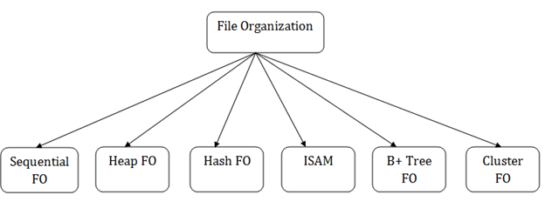

Slide 8
Sequential File Organization
This method is the easiest method for file organization.
In this method, files are stored sequentially. This method can be implemented in two ways:
1. Pile File Method
2. Sorted File Method

Slide 9
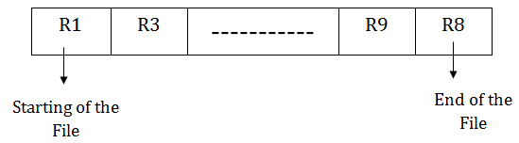
Pile File Method
It is a quite simple method.
In this method, we store the record in a sequence, i.e., one after another. Here, the record will be inserted in the order in which they are inserted into tables.
In case of updating or deleting of any record, the record will be searched in the memory blocks. When it is found, then it will be marked for deleting, and the new record is inserted.

Slide 10
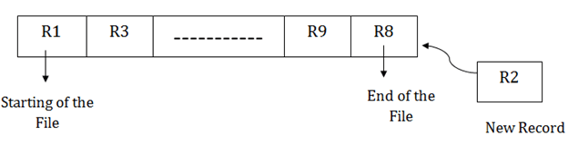
Insertion of new record
Suppose we have four records R1, R3 and so on upto R9 and R8 in a sequence.
Suppose we want to insert a new record R2 in the sequence, then it will be placed at the end of the file.
Here, records are nothing but a row in any table.

Slide 11
Sorted File Method
In this method, the new record is always inserted at the file's end, and then it will sort the sequence in ascending or descending order.
Sorting of records is based on any primary key or any other key.
In the case of modification of any record, it will update the record and then sort the file, and lastly, the updated record is placed in the right place.

Slide 12
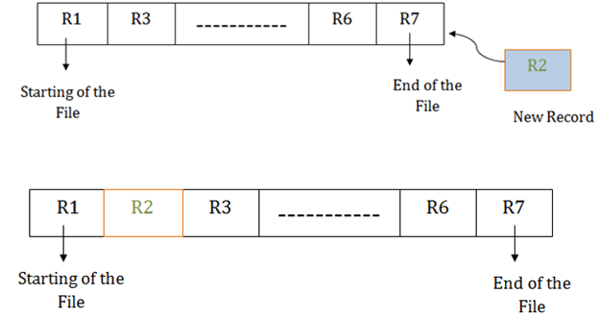
Insertion of new record
Suppose there is a preexisting sorted sequence of four records R1, R3 and so on upto R6 and R7.
Suppose a new record R2 has to be inserted in the sequence, then it will be inserted at the end of the file, and then it will sort the sequence.

Slide 13
PROS of Sequential File Organization
It contains a fast and efficient method for the huge amount of data.
In this method, files can be easily stored in cheaper storage mechanism like magnetic tapes.
It is simple in design. It requires no much effort to store the data.
This method is used when most of the records have to be accessed like grade calculation of a student, generating the salary slip, etc.
This method is used for report generation or statistical calculations.

Slide 14
CONS of File Organisation
It will waste time as we cannot jump on a particular record that is required but we have to move sequentially which takes our time.
Sorted file method takes more time and space for sorting the records.

Slide 15
Heap File Organization
It is the simplest and most basic type of organization. It works with data blocks.
In heap file organization, the records are inserted at the file's end. When the records are inserted, it doesn't require the sorting and ordering of records.
When the data block is full, the new record is stored in some other block. This new data block need not to be the very next data block, but it can select any data block in the memory to store new records. The heap file is also known as an unordered file.
In the file, every record has a unique id, and every page in a file is of the same size.
It is the DBMS responsibility to store and manage the new records.

Slide 16
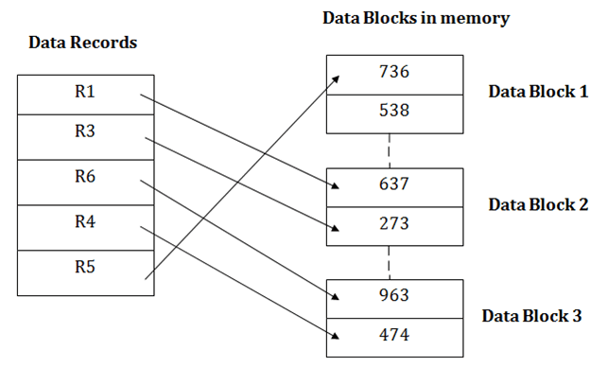

Slide 17
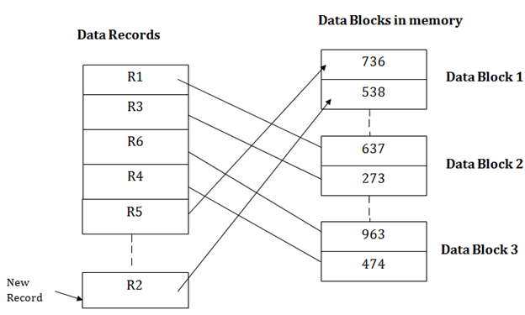
Insertion of a new record
Suppose we have five records R1, R3, R6, R4 and R5 in a heap and suppose we want to insert a new record R2 in a heap. If the data block 3 is full then it will be inserted in any of the database selected by the DBMS, let's say data block 1.

Slide 18
If we want to search, update or delete the data in heap file organization, then we need to traverse the data from staring of the file till we get the requested record.
If the database is very large then searching, updating or deleting of record will be time-consuming because there is no sorting or ordering of records. In the heap file organization, we need to check all the data until we get the requested record.

Slide 19
PROS of Heap File Organization
It is a very good method of file organization for bulk insertion. If there is a large number of data which needs to load into the database at a time, then this method is best suited.
In case of a small database, fetching and retrieving of records is faster than the sequential record.

Slide 20
CONS of Heap File Organization
This method is inefficient for the large database because it takes time to search or modify the record.

Slide 21
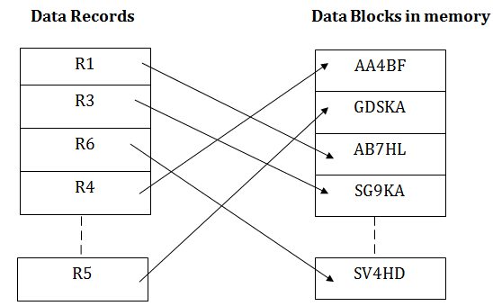
Hash File Organization
Hash File Organization uses the computation of hash function on some fields of the records.
The hash function's output determines the location of disk block where the records are to be placed.

Slide 22
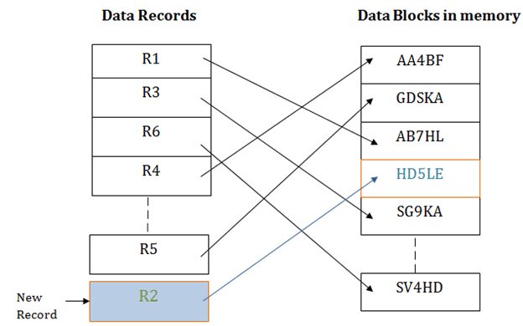
When a record has to be received using the hash key columns, then the address is generated, and the whole record is retrieved using that address.
In the same way, when a new record has to be inserted, then the address is generated using the hash key and record is directly inserted. The same process is applied in the case of delete and update.
In this method, there is no effort for searching and sorting the entire file. In this method, each record will be stored randomly in the memory.

Slide 23
B+ File Organization
B+ tree file organization is the advanced method of an indexed sequential access method. It uses a tree-like structure to store records in File.
It uses the same concept of key-index where the primary key is used to sort the records. For each primary key, the value of the index is generated and mapped with the record.
The B+ tree is similar to a binary search tree (BST), but it can have more than two children.
In this method, all the records are stored only at the leaf node. Intermediate nodes act as a pointer to the leaf nodes. They do not contain any records.

Slide 24
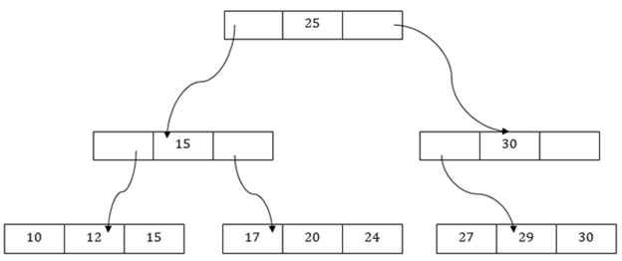
The below B+ tree showed that:
There is one root node of the tree, i.e., 25.
There is an intermediary layer with nodes. They do not store the actual record. They have only pointers to the leaf node.
The nodes to the left of the root node contain the prior value of the root and nodes to the right contain next value of the root, i.e., 15 and 30 respectively.
There is only one leaf node which has only values, i.e., 10, 12, 17, 20, 24, 27 and 29.
Searching for any record is easier as all the leaf nodes are balanced.
In this method, searching any record can be traversed through the single path and accessed easily.

Slide 25
PROS of B+ Tree File Organization
In this method, searching becomes very easy as all the records are stored only in the leaf nodes and sorted the sequential linked list.
Traversing through the tree structure is easier and faster.
The size of the B+ tree has no restrictions, so the number of records can increase or decrease and the B+ tree structure can also grow or shrink.
It is a balanced tree structure, and any insert/update/delete does not affect the performance of tree.

Slide 26
CONS of B+ Tree File Organization
This method is inefficient for the static method.

Slide 27
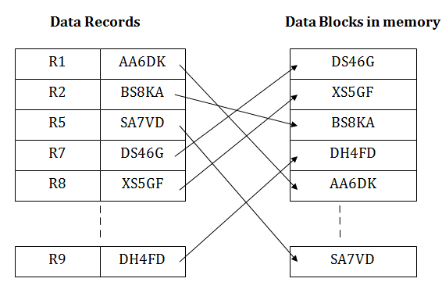
Indexed Sequential Access Method (ISAM)
ISAM method is an advanced sequential file organization.
In this method, records are stored in the file using the primary key.
An index value is generated for each primary key and mapped with the record. This index contains the address of the record in the file.
If any record has to be retrieved based on its index value, then the address of the data block is fetched and the record is retrieved from the memory.

Slide 28
PROS of ISAM
In this method, each record has the address of its data block, searching a record in a huge database is quick and easy.
This method supports range retrieval and partial retrieval of records. Since the index is based on the primary key values, we can retrieve the data for the given range of value. In the same way, the partial value can also be easily searched, i.e., the student name starting with 'JA' can be easily searched.

Slide 29
CONS of ISAM
This method requires extra space in the disk to store the index value.
When the new records are inserted, then these files have to be reconstructed to maintain the sequence.
When the record is deleted, then the space used by it needs to be released. Otherwise, the performance of the database will slow down.

Slide 30
Cluster File Organization
When the two or more records are stored in the same file, it is known as clusters. These files will have two or more tables in the same data block, and key attributes which are used to map these tables together are stored only once.
This method reduces the cost of searching for various records in different files.
The cluster file organization is used when there is a frequent need for joining the tables with the same condition. These joins will give only a few records from both tables.
In the given example, we are retrieving the record for only particular departments. This method can't be used to retrieve the record for the entire department.
In this method, we can directly insert, update or delete any record. Data is sorted based on the key with which searching is done. Cluster key is a type of key with which joining of the table is performed.

Slide 31
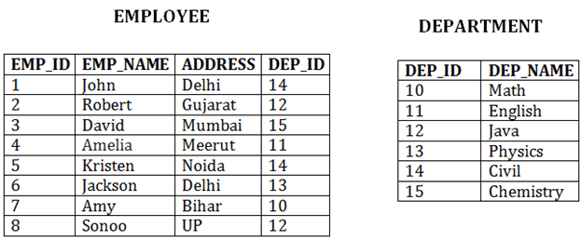
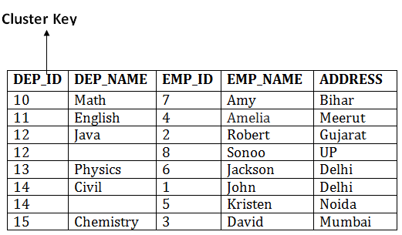

Slide 32
Types of Cluster file organization:
1. Indexed Clusters
2. Hash Clusters

Slide 33
1. Indexed Clusters:
In indexed cluster, records are grouped based on the cluster key and stored together.
The above EMPLOYEE and DEPARTMENT relationship is an example of an indexed cluster. Here, all the records are grouped based on the cluster key- DEP_ID and all the records are grouped.

Slide 34
2. Hash Clusters:
It is similar to the indexed cluster.
In hash cluster, instead of storing the records based on the cluster key, we generate the value of the hash key for the cluster key and store the records with the same hash key value.

Slide 35
PROS of Cluster File Organization
The cluster file organization is used when there is a frequent request for joining the tables with same joining condition.
It provides the efficient result when there is a 1:M (One to Many) mapping between the tables.

Slide 36
CONS of Cluster File Organization
This method has the low performance for the very large database.
If there is any change in joining condition, then this method cannot use. If we change the condition of joining then traversing the file takes a lot of time.
This method is not suitable for a table with a 1:1 condition.

